Slide 1
Ratings Prediction Project.
Presentation By : OLIVER RAMAN | Internship 26

Slide 2
Agenda.
Overview.
Problem Statement.
Problem Understanding.
What is Ratings Prediction?
Importance of Ratings Prediction.
Exploratory data analysis.
Visualizations.
Analysis.
Model Building.
Hyper Parameter Tuning.
Saving the model and making predictions.
Conclusion.

Slide 3
Overview.
In this particular presentation we will be looking into:
How to analyze the dataset of Rating Prediction Project?
What are the EDA steps in cleaning the dataset?
Overall analysis on the problem.
Model building from the cleaned dataset.
Saving the best model.

Slide 4
Problem statement.

Slide 5
We have a client who has a website where people write different reviews for technical products.
Now they are adding a new feature to their website i.e. The reviewer will have to add stars(rating) as well with the review. The rating is out 5 stars and it only has 5 options available 1 star, 2 stars, 3 stars, 4 stars, 5 stars.
Now they want to predict ratings for the reviews which were written in the past and they don’t have a rating.
So, we have to build an application which can predict the rating by seeing the review.

Slide 6
Problem understanding.
Ratings prediction is a well-known recommendation task aiming to predict a user’s rating for those items which were not rated yet by him/her. Predictions are computed from users’ explicit feedback, i.e. their ratings provided on some items in the past.
Another type of feedback are user reviews provided on items which implicitly express users’ opinions on items.

Slide 7

Problem understanding.
Recent studies indicate that opinions inferred from users’ reviews on items are strong predictors of user’s implicit feedback or even ratings and thus, should be utilized in computation.

Slide 8
What is Ratings prediction ?
The rise in E — commerce, has brought a significant rise in the importance of customer reviews. There are hundreds of review sites online and massive amounts of reviews for every product.
The ability to successfully decide whether a review will be helpful to other customers and thus give the product more exposure is vital to companies that support these reviews, companies like Google, Amazon and Yelp!.

Slide 9
What is Ratings prediction ?
Rating prediction is a well-known recommendation task aiming to predict a user's rating for those items which were not rated yet by him/her.
Predictions are computed from users' explicit feedback, i.e. their ratings provided on some items in the past.
Review Rating Prediction aims to predict a user's numeric rating (usually from 1 to 5 stars) in a review from the text of the review.

Slide 10
Importance of Ratings prediction.
The text of a review is often overlooked in such predictive tasks in favour of features such as the user’s and business’ previous rating history.
However, if the sentiment of the text of a user’s review can be estimated suitably, it would be the best indicator of the rating.
Ultimately, a review is what the opinion of the user is about the business in his own words and not a mathematical predictive task.

Slide 11
Importance of Ratings prediction.
Thus, it is essential to be able to predict what the user feels about a business from the review text and this is the task of rating prediction from review text was chosen.

Slide 12
Exploratory Data Analysis
Importing necessary libraries and loading the dataset as a data frame.
Checked some statistical information like shape, number of unique values present, info, null values, value counts, etc.
Checked for null values and I replaced those null values using imputation method.

Slide 13
Exploratory Data Analysis
text pre-processing was done like Removing Punctuations and other special characters, Splitting the comments into individual words, Removing Stop Words, Stemming, Lemmatization etc.
Visualized each feature using seaborn and matplotlib libraries by plotting distribution plot and word cloud for each ratings.

Slide 14
Exploratory Data Analysis
After cleaning the data, TF-IDF vectorizer was used.
It’ll help transform the text data to feature vectors which can be used as input in our model building.
Mathematically, TF-IDF = TF(t*d)*IDF(t,d).

Slide 15
Visualizations.

Slide 16
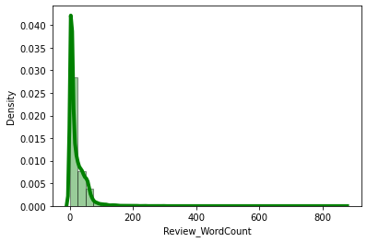
OBSERVATION : By observing the histogram we can clearly see that most of our text is having a word count in the range of 0 to 200. But some of the reviews are too lengthy which may act like outliers in our data.

Slide 17
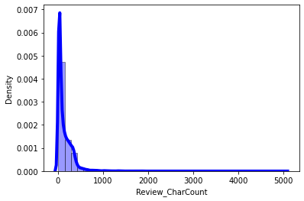
OBSERVATION : The above plot represents histogram for character counts of Review text, which is quite similar to the histogram of word count. Most of the characters are between 0 - 1000.

Slide 18
Some of the reviews are too lengthy, so we have to treat them as outliers and remove them using z_score method.
After removing the outliers the word count and character count looks as below.

Slide 19
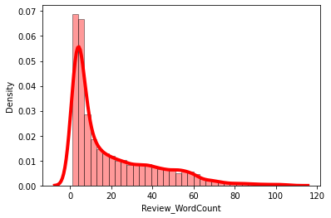
OBSERVATION : After plotting histograms for word counts after removing outliers we can see we are left out with a good range of number of words.

Slide 20
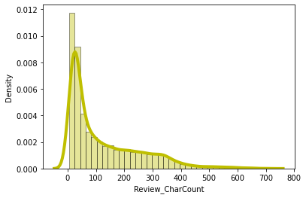
OBSERVATION : After plotting histograms for character counts and after removing outliers we can see we are left out with a good range of number of characters.

Slide 21
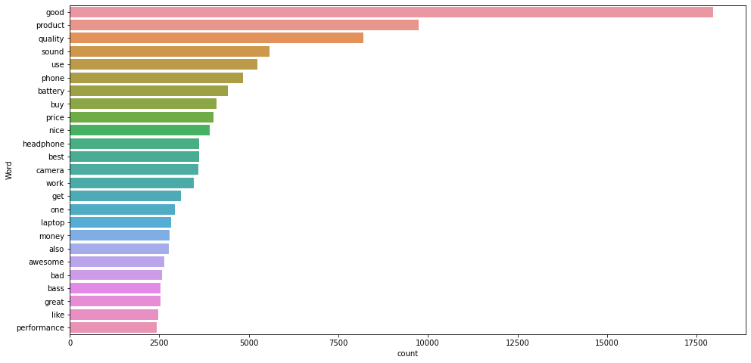
OBSERVATION : the Above list of words have a frequent occurrence. Mainly, good, product & quality.

Slide 22
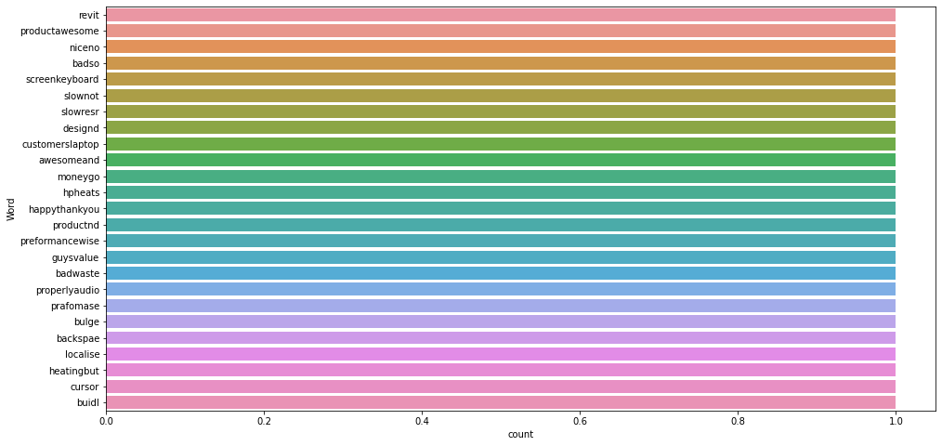
OBSERVATION : Above list of words have rare occurrence in Review. Only 1 time each.

Slide 23
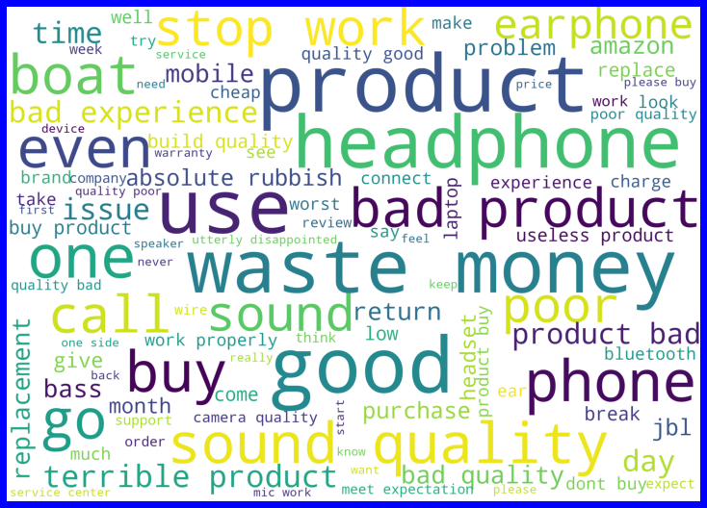
OBSERVATION : Above is the word cloud of words used most frequently to least with the rating of 1 star.

Slide 24
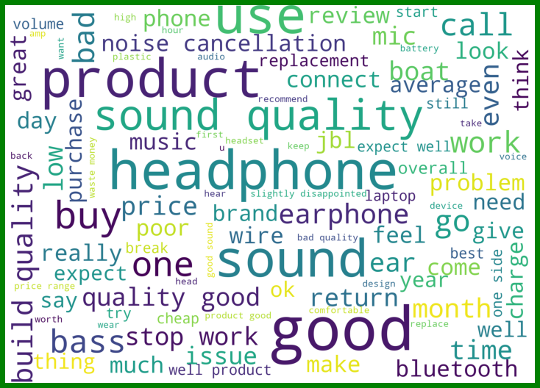
OBSERVATION : Above is the word cloud of words used most frequently to least with the rating of 2 stars.

Slide 25
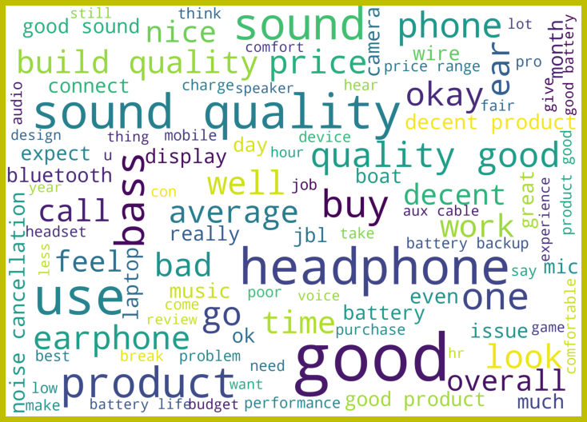
OBSERVATION : Above is the word cloud of words used most frequently to least with the rating of 3 stars.

Slide 26
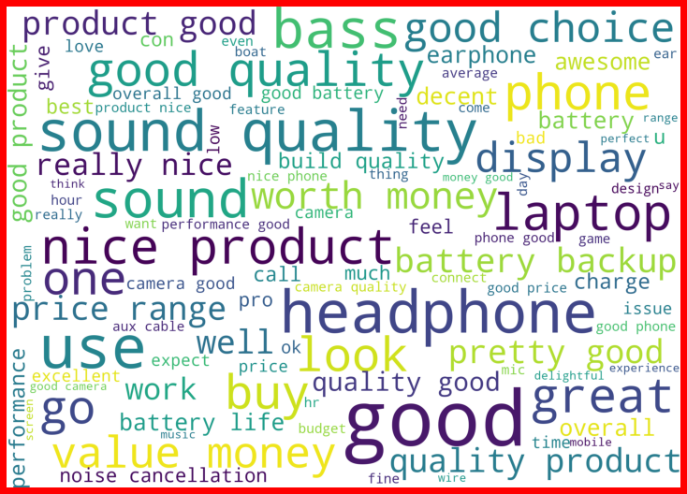
OBSERVATION : Above is the word cloud of words used most frequently to least with the rating of 4 stars.

Slide 27
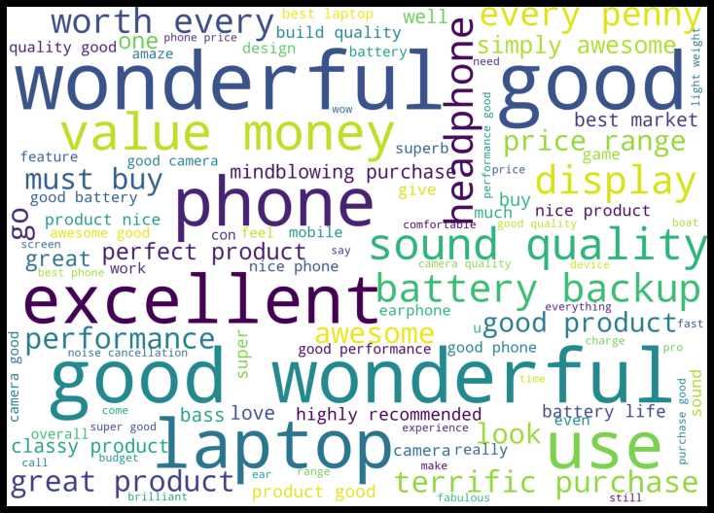
OBSERVATION : Above is the word cloud of words used most frequently to least with the rating of 5 stars.

Slide 28
Analysis.
This project is about exploration, feature engineering and classification.
Since the data set is huge and includes multi-classification of ratings, we can do good amount of data exploration and derive some interesting features using the review text column.
We have removed extra spaces, converted email address into email keyword, likewise phone numbers etc. Tried to make Reviews small and more appropriate as much as possible.

Slide 29
Analysis.
After getting the data cleaned, we used TF-IDF vectorizer. It’ll help to transform the text data to feature vector which can be used as input in our modelling. It is a common algorithm to transform text into numbers. It measures the originality of a word by comparing the frequency of appearance of a word in a document with the number of documents the words appear in.
Lastly, balanced the data using SMOTE and proceeded with model building.

Slide 30
Model Building.

Slide 31
In this project, we need to predict ratings which are multi-classifiers. We have converted the text into vectors using TFIDF vectorizer and separated our feature and Target, then build the model.
I have chosen the Logistic Regression as best suitable algorithm for our final model as it is performed well compared to the other algorithms.

Slide 32
I have used following algorithms and evaluated them:
Logistic Regression.
DecisionTreeClassifier.
RandomForestClassifier.
Extra Trees Classifier.
Support Vector Classifier.

Slide 33
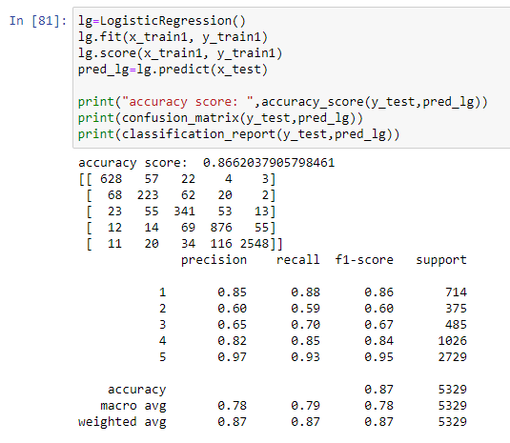
Logistic Regression Model.
The Logistic Regression model gave us an accuracy Score of 86.62 %.

Slide 34
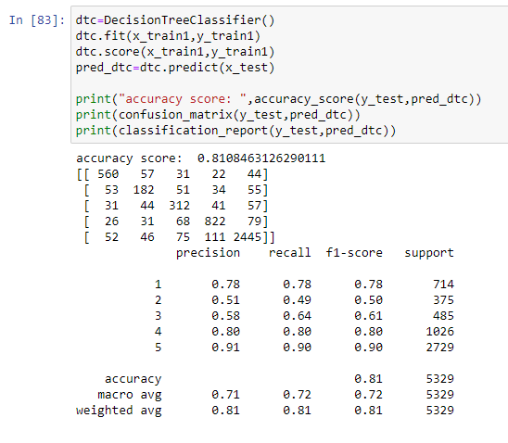
Decision Tree Classifier Model.
The Decision Tree Classifier Model gave us an accuracy Score of 81.08%.

Slide 35
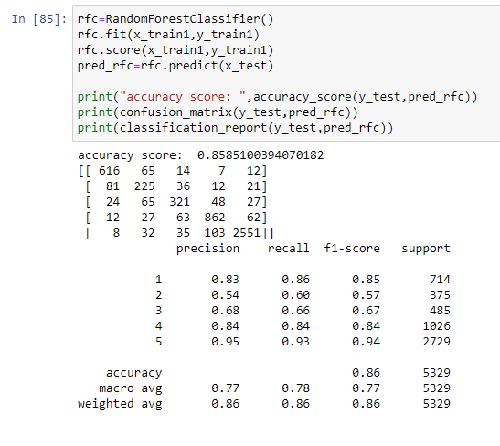
Random Forest Classifier Model.
The Random Forest Classifier model gave us an accuracy Score of 85.85 %.

Slide 36
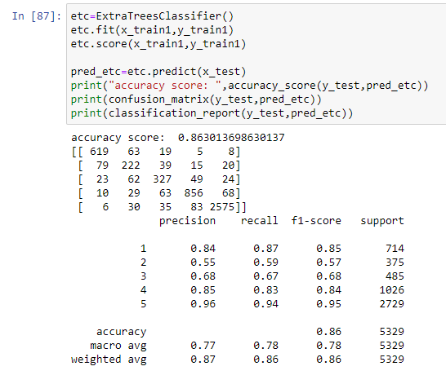
Extra Trees Classifier Model.
The Extra Trees Classifier model gave us an accuracy Score of 86.30 %.

Slide 37
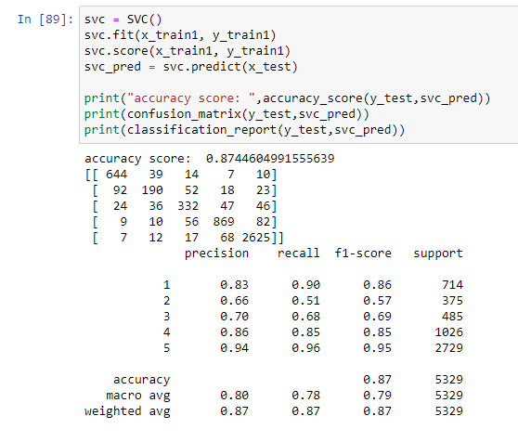
Support Vector Classifier Model.
The Support Vector Classifier (SVC) model gave us an accuracy Score of 87.44 %.

Slide 38
Analysis of models.
From the above classification models, the highest accuracy score belongs to the SVC Model. Followed by the Logistic Regression Model.
Next the Extra Trees Classifier model & Random Forest Classifier model.
Lastly, the Decision Tree Classifier model has the lowest accuracy score among the other models.

Slide 39
Cross validation scores.
The cross validation score of the Logistic Regression Model is 80.26 %.
The cross validation score of the Decision Tree Classifier Model is 72.40 %.
The cross validation score of the Random Forest Classifier Model is 78.61 %.
The cross validation score of the Extra Trees Classifier Model is 78.87 %.
The cross validation score of the Support Vector Classifier (SVC) Model is 80.21 %.

Slide 40
Cross validation scores.
From the above Cross Validation Scores, the highest score belongs to Logistic Regression Model. Followed by the SVC Model.
Next, the Extra Trees Classifier model & Random Forest Classifier model.
Lastly, the Decision Tree Classifier model.

Slide 41
Hyper Parameter Tuning.

Slide 42
Since the Accuracy Score and the Cross Validation Score of the Logistic Regression Model have the least difference between them, we shall consider it for hyper parameter tuning.
We shall use GridSearchCV for hyper parameter tuning.

Slide 43
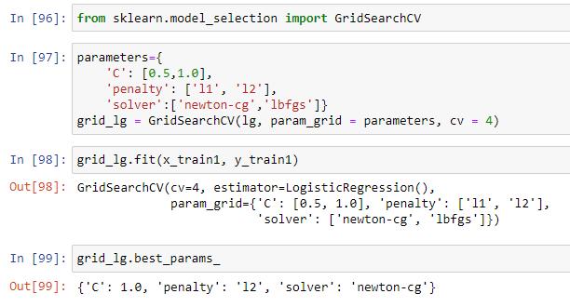

Slide 44
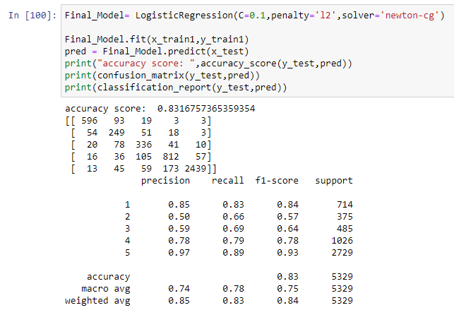

Slide 45
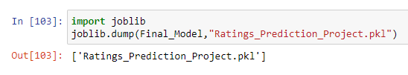
Saving the Model.
Logistic Regression Model is our best model with accuracy of 83.16 %.

Slide 46
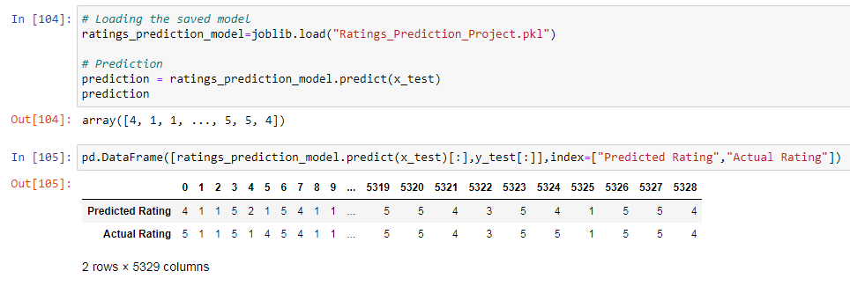
Prediction From Saved Model.
The actual and predicted values are almost similar.

Slide 47
Conclusion.
In this project, we have used machine learning algorithms to predict the Ratings.
We have mentioned the step by step procedure in analyzing & preparing the dataset and finding the correlation between the features.
Data cleaning is an important step in model building to remove unrealistic values and unnecessary punctuations, urls, email address, stop words, etc.

Slide 48
Conclusion.
visualization tools such as distribution plots, histograms & word clouds helped us in understanding the data.
The cleaned data was given as an input to 5 algorithms and a hyper parameter tuning was done to find the best model.
We calculated the performance of each model using different performance metrics and compared them based on these metrics.
Finally, we saved the best model.

